Slide 1

Environmental Science Project:
City Temperature Dataset

Slide 2

Dataset Source and Justification
Dataset:
City Temperature DatasetKaggle( https://www.kaggle.com/datasets/sudalairajkumar/daily-temperature-of-major-cities )
Justification:
This dataset contains over 2.8 million records of daily average temperatures from various global cities. It is highly suitable for environmental science studies due to its temporal and geographical richness. It allows us to analyze climate trends, compare temperature profiles across continents, and potentially correlate temperature with environmental or agricultural events.

Slide 3

INTRODUCTION
This project explores the City Temperature dataset from Kaggle to analyze global temperature trends for environmental insights.

Slide 4

Variable Types
Character
Numeric
Region
Country,
State
City
Month
Day
Year
AvgTemperature

Slide 5

Dataset Overview
The dataset contains over 2.8 million records from global cities, including daily temperature, location, and time information.

Slide 6

Data Cleaning Summary
Removed duplicates, handled missing values with na.omit(), and filtered out incomplete rows. Ensured unique, clean entries.

Slide 7
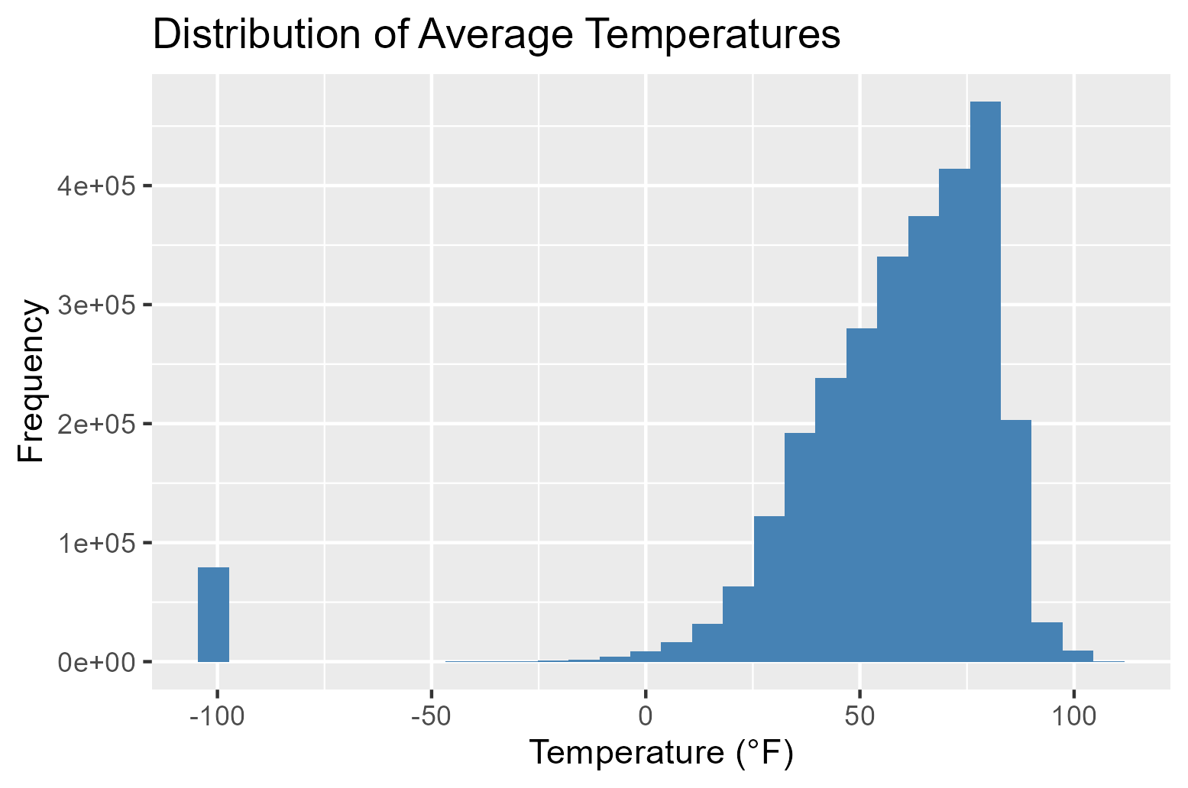

Histogram
Removed duplicates, handled missing values with na.omit(), and filtered out incomplete rows. Ensured unique, clean entries.

Slide 8
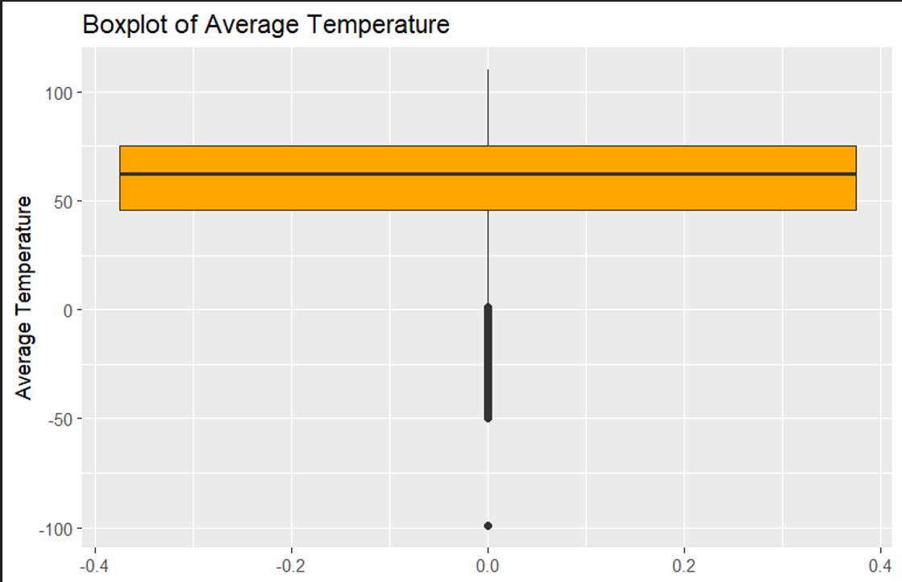

Boxplots
Boxplot by month shows warmer temperatures mid-year, with cooler readings at the beginning and end of the year.

Slide 9

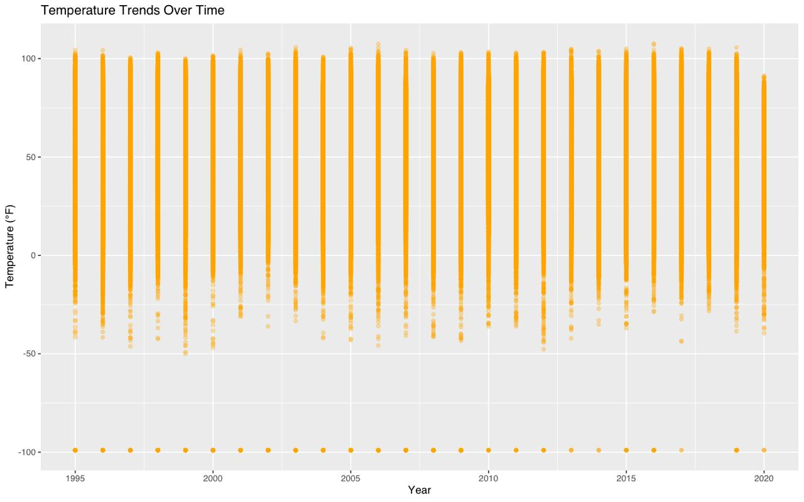
Scatter Plots
Scatter plot of temperature over years shows variability and potential warming trends.

Slide 10
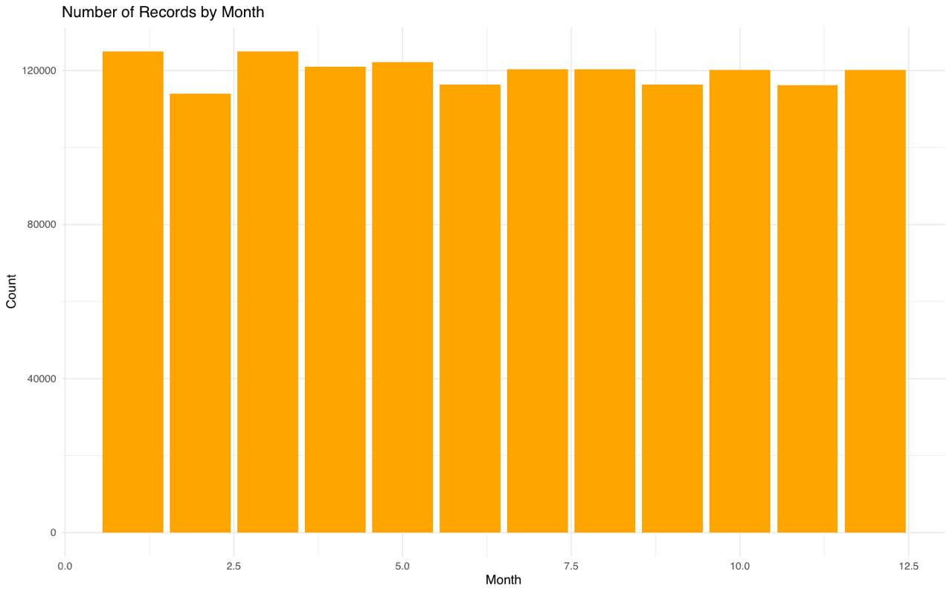

Bar Plot by Region
Bar chart shows uneven distribution of records across regions—North America, Asia more represented.

Slide 11

Correlation Matrix
Heatmap shows strong inter-date correlation (Month, Day, Year), but weak link between temperature and individual date parts

Slide 12
Key Trends & Patterns
Temperature patterns reflect seasonal cycles; certain cities and regions show consistent profiles over time.

Slide 13

4. Correlation Analysis
The Pearson correlation test was used to check relationships between average temperature and numerical variables:
Variable | Correlation (r) | p-value | Interpretation
Day | 0.0064 | < 2.2e-16 | Very weak positive correlation, statistically significant.
Year | -0.044 | < 2.2e-16 | Very weak negative correlation, statistically significant.
Although statistically significant due to large data size, these correlations are practically negligible.

Slide 14
5. ANOVA (Analysis of Variance)
To assess the effect of categorical variables on average temperature
Variable | Df | F-value | p-value | Interpretation
Region | 6 | 90695 | < 2e-16 | Significant differences in temperature between regions.
Country | 124 | 8893 | < 2e-16 | Significant differences in temperature between countries.
State | 52 | 8809 | < 2e-16 | Significant differences in temperature between states.
Month | 11 | 125358 | < 2e-16 | Strong seasonal variation in temperature
Although statistically significant due to large data size, these correlations are practically negligible.

Slide 15
CONCLUSION
The dataset offers significant value for climate pattern analysis and supports environmental research through visual and statistical insights.

